Slide 1
Logical reasoning systems
Theorem provers and logic programming languages
Production systems
Frame systems and semantic networks
Description logic systems

Slide 2
Logical reasoning systems
Theorem provers and logic programming languages – Provers: use
resolution to prove sentences in full FOL. Languages: use backward
chaining on restricted set of FOL constructs.
Production systems – based on implications, with consequents
interpreted as action (e.g., insertion & deletion in KB). Based on
forward chaining + conflict resolution if several possible actions.
Frame systems and semantic networks – objects as nodes in a
graph, nodes organized as taxonomy, links represent binary
relations.
Description logic systems – evolved from semantic nets. Reason
with object classes & relations among them.

Slide 3
Basic tasks
Add a new fact to KB – TELL
Given KB and new fact, derive facts implied by conjunction of KB and new fact. In forward chaining: part of TELL
Decide if query entailed by KB – ASK
Decide if query explicitly stored in KB – restricted ASK
Remove sentence from KB: distinguish between correcting false sentence, forgetting useless sentence, or updating KB re. change in the world.

Slide 4
Indexing, retrieval & unification
Implementing sentences & terms: define syntax and map sentences onto machine representation.
Compound: has operator & arguments.
e.g., c = P(x) ∧ Q(x) Op[c] = ∧; Args[c] = [P(x), Q(x)]
FETCH: find sentences in KB that have same structure as query.
ASK makes multiple calls to FETCH.
STORE: add each conjunct of sentence to KB. Used by TELL.
e.g., implement KB as list of conjuncts
TELL(KB, A ∧ ¬B) TELL(KB, ¬C ∧ D)
then KB contains: [A, ¬B, ¬C, D]

Slide 5
Complexity
With previous approach,
FETCH takes O(n) time on n-element KB
STORE takes O(n) time on n-element KB (if check for duplicates)
Faster solution?

Slide 6
Table-based indexing
What are you indexing on? Predicates (relations/functions). Example:
Key | Positive | Negative | Conclu-sion | Premise
Mother | Mother(ann,sam) Mother(grace,joe) | -Mother(ann,al) | xxxx | xxxx
dog | dog(rover) dog(fido) | -dog(alice) | xxxx | xxxx

Slide 7
Table-based indexing
Use hash table to avoid looping over entire KB for each TELL or FETCH
e.g., if only allowed literals are single letters, use a 26-element array to store their values.
More generally:
- convert to Horn form
- index table by predicate symbol
- for each symbol, store:
list of positive literals
list of negative literals
list of sentences in which predicate is in conclusion
list of sentences in which predicate is in premise

Slide 8
Tree-based indexing
Hash table impractical if many clauses for a given predicate symbol
Tree-based indexing (or more generally combined indexing):
compute indexing key from predicate and argument symbols
Predicate?
First arg?

Slide 9
Tree-based indexing
Example:
Person(age,height,weight,income)
Person(30,72,210,45000)
Fetch( Person(age,72,210,income))
Fetch(Person(age,height>72,weight<210,income))

Slide 10
Unification algorithm: Example
Understands(mary,x) implies Loves(mary,x)
Understands(mary,pete) allows the system to substitute pete for x and make the implication that IF
Understands(mary,pete) THEN Loves(mary,pete)

Slide 11
Unification algorithm
Using clever indexing, can reduce number of calls to unification
Still, unification called very often (at basis of modus ponens) => need efficient implementation.
See AIMA p. 303 for example of algorithm with O(n^2) complexity
(n being size of expressions being unified).

Slide 12
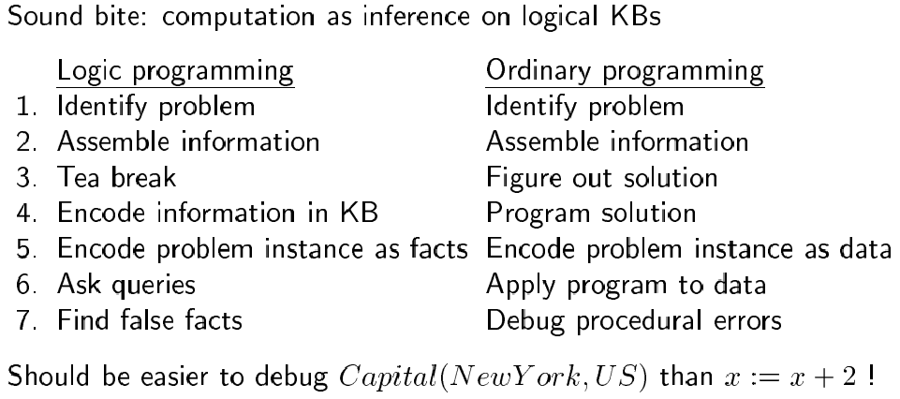
Logic programming
Remember: knowledge engineering vs. programming…

Slide 13
Logic programming systems
e.g., Prolog:
Program = sequence of sentences (implicitly conjoined)
All variables implicitly universally quantified
Variables in different sentences considered distinct
Horn clause sentences only (= atomic sentences or sentences with no negated antecedent and atomic consequent)
Terms = constant symbols, variables or functional terms
Queries = conjunctions, disjunctions, variables, functional terms
Instead of negated antecedents, use negation as failure operator: goal NOT P considered proved if system fails to prove P
Syntactically distinct objects refer to distinct objects
Many built-in predicates (arithmetic, I/O, etc)

Slide 14
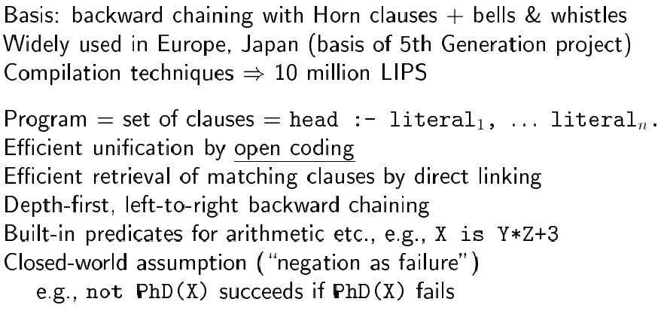
Prolog systems

Slide 15
Basic syntax of facts, rules and queries
<fact> ::= <term> .
<rule> ::= <term> :- <term> .
<query> ::= <term> .
<term> ::= <number> | <atom> | <variable>
| <atom> (<terms>)
<terms> ::= <term> | <term>, <terms>

Slide 16
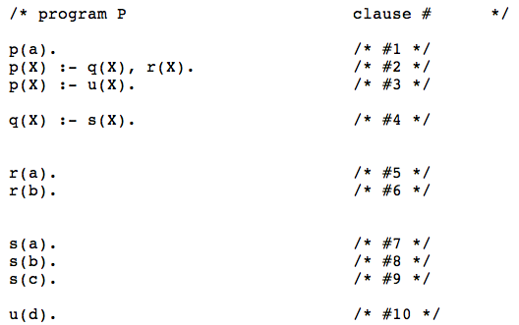
Basic syntax of facts, rules and queries
https://www.csupomona.edu/~jrfisher/www/prolog_tutorial/contents.html
q(X) ^ r(X) => p(X)

Slide 17
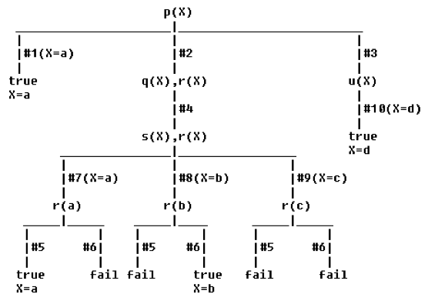
Basic syntax of facts, rules and queries
https://www.csupomona.edu/~jrfisher/www/prolog_tutorial/contents.html
Query for p(X) (i.e., for which values
of X is p(X) true):

Slide 18
A PROLOG Program
A PROLOG program is a set of facts and rules.
A simple program with just facts :
parent(alice, jim).
parent(jim, tim).
parent(jim, dave).
parent(jim, sharon).
parent(tim, james).
parent(tim, thomas).

Slide 19
A PROLOG Program
c.f. a table in a relational database.
Each line is a fact (a.k.a. a tuple or a row).
Each line states that some person X is a parent of some (other) person Y.
In GNU PROLOG the program is kept in an ASCII file.

Slide 20
A PROLOG Query
Now we can ask PROLOG questions :
| ?- parent(alice, jim).
yes
| ?- parent(jim, herbert).
no
| ?-

Slide 21
A PROLOG Query
Not very exciting. But what about this :
| ?- parent(alice, Who).
Who = jim
yes
| ?-
Who is called a logical variable.
PROLOG will set a logical variable to any value which makes the query succeed.

Slide 22
A PROLOG Query II
Sometimes there is more than one correct answer to a query.
PROLOG gives the answers one at a time. To get the next answer type ;.
| ?- parent(jim, Who).
Who = tim ? ;
Who = dave ? ;
Who = sharon ? ;
yes
| ?-
NB : The ; do not actually appear on the screen.

Slide 23
A PROLOG Query II
| ?- parent(jim, Who).
Who = tim ? ;
Who = dave ? ;
Who = sharon ? ;
yes
| ?-
After finding that jim was a parent of sharon GNU PROLOG detects that there are no more alternatives for parent and ends the search.
NB : The ; do not actually appear on the screen.

Slide 24
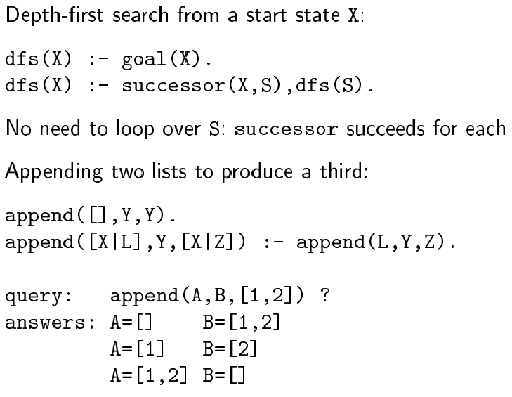
Prolog example
conjunction

Slide 25
Append
append([], L, L)
append([H| L1], L2, [H| L3]) :- append(L1, L2, L3)
Example join [a, b, c] with [d, e].
[a, b, c] has the recursive structure [a| [b, c] ].
Then the rule says:
IF [b,c] appends with [d, e] to form [b, c, d, e] THEN [a|[b, c]] appends with [d,e] to form [a|[b, c, d, e]]
i.e. [a, b, c] [a, b, c, d, e]

Slide 26
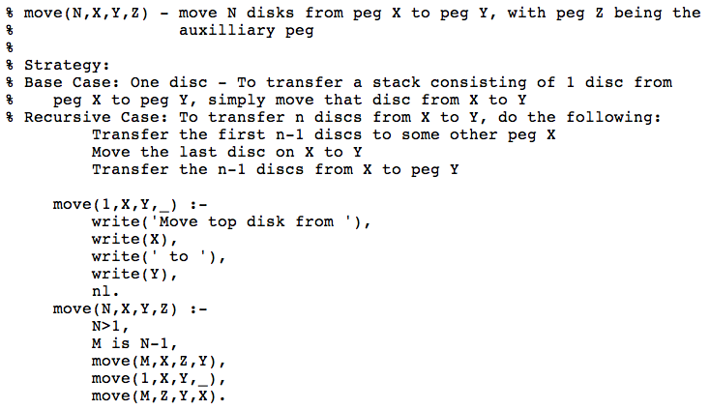
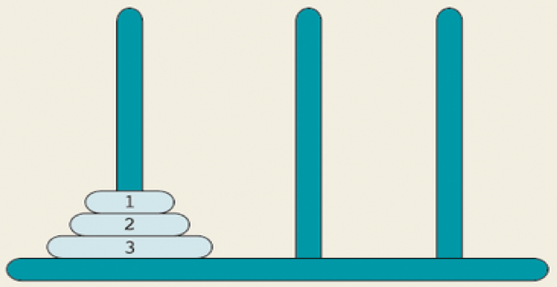
Tower of Hanoi in Prolog
https://www.csupomona.edu/~jrfisher/www/prolog_tutorial/contents.html
http://www.cs.toronto.edu/~sheila/384/w11/simple-prolog-examples.html
Anonymous variable _
Write a newline

Slide 27
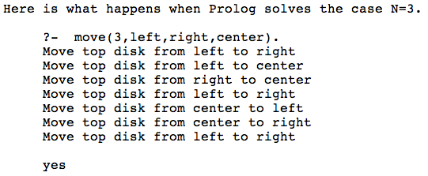
Tower of Hanoi in Prolog
https://www.csupomona.edu/~jrfisher/www/prolog_tutorial/contents.html
http://www.cs.toronto.edu/~sheila/384/w11/simple-prolog-examples.html

Slide 28
Expanding Prolog
Parallelization:
OR-parallelism: goal may unify with many different literals and
implications in KB
AND-parallelism: solve each conjunct in body of an implication
in parallel
Compilation: generate built-in theorem prover for different predicates in KB
Optimization: for example through re-ordering
e.g., “what is the income of the spouse of the president?”
Income(s, i) ∧ Married(s, p) ∧ Occupation(p, President)
faster if re-ordered as:
Occupation(p, President) ∧ Married(s, p) ∧ Income(s, i)

Slide 29
Theorem provers
Differ from logic programming languages in that:
- accept full FOL
- results independent of form in which KB entered

Slide 30
OTTER
Organized Techniques for Theorem Proving and Effective Research (McCune, 1992)
Set of support (sos): set of clauses defining facts about problem
Each resolution step: resolves member of sos against other axiom
Usable axioms (outside sos): provide background knowledge about domain
Rewrites (or demodulators): define canonical forms into which terms can be simplified. E.g., x+0=x
Control strategy: defined by set of parameters and clauses. E.g., heuristic function to control search, filtering function to eliminate uninteresting subgoals.

Slide 31
OTTER
Operation: resolve elements of sos against usable axioms
Use best-first search: heuristic function measures “weight” of each clause (lighter weight preferred; thus in general weight correlated with size/difficulty)
At each step: move lightest close in sos to usable list, and add to usable list consequences of resolving that close against usable list
Halt: when refutation found or sos empty

Slide 32
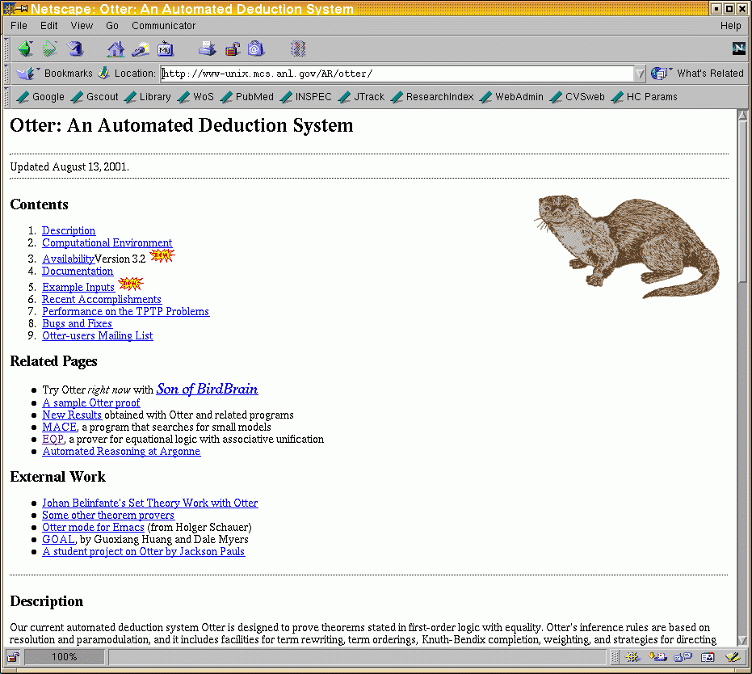
Example

Slide 33
Example: Robbins Algebras Are Boolean
The Robbins problem---are all Robbins algebras Boolean?---has been solved: Every Robbins algebra is Boolean. This theorem was proved automatically by EQP, a theorem proving program developed at Argonne National Laboratory

Slide 34
Example: Robbins Algebras Are Boolean
Historical Background
In 1933, E. V. Huntington presented the following basis for Boolean algebra:
x + y = y + x. [commutativity]
(x + y) + z = x + (y + z). [associativity]
n(n(x) + y) + n(n(x) + n(y)) = x. [Huntington equation]
Shortly thereafter, Herbert Robbins conjectured that the Huntington equation can be replaced with a simpler one:
n(n(x + y) + n(x + n(y))) = x. [Robbins equation]
Robbins and Huntington could not find a proof, and the problem was later studied by Tarski and his students

Slide 35
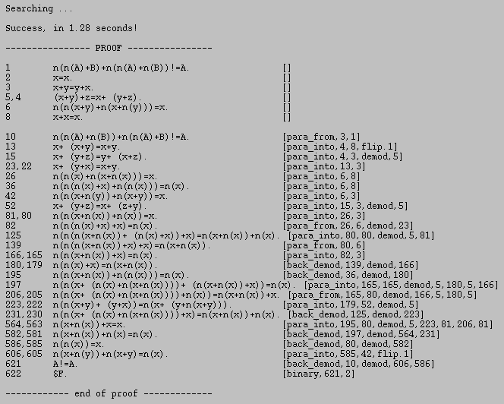
Given to the system

Slide 36
Forward-chaining production systems
Prolog & other programming languages: rely on backward-chaining
(I.e., given a query, find substitutions that satisfy it)
Forward-chaining systems: infer everything that can be inferred from KB each time new sentence is TELL’ed
Appropriate for agent design: as new percepts come in, forward-chaining returns best action

Slide 37
Implementation
One possible approach: use a theorem prover, using resolution to forward-chain over KB
More restricted systems can be more efficient.
Typical components:
- KB called “working memory” (positive literals, no variables)
- rule memory (set of inference rules in form
p1 ∧ p2 ∧ … ⇒ act1 ∧ act2 ∧ …
- at each cycle: find rules whose premises satisfied
by working memory (match phase)
- decide which should be executed (conflict resolution phase)
- execute actions of chosen rule (act phase)

Slide 38
Match phase
Unification can do it, but inefficient
Rete algorithm (used in OPS-5 system): example
rule memory:
A(x) ∧ B(x) ∧ C(y) ⇒ add D(x)
A(x) ∧ B(y) ∧ D(x) ⇒ add E(x)
A(x) ∧ B(x) ∧ E(x) ⇒ delete A(x)
working memory:
{A(1), A(2), B(2), B(3), B(4), C(5)}
Build Rete network from rule memory, then pass working memory through it

Slide 39
Rete network
D A=D add E
A B A=B C add D
E A=E delete A
C(5)
D(2)
A(1),
A(2)
B(2),
B(3),
B(4)
A(2),
B(2)
Circular nodes: fetches to WM; rectangular nodes: unifications
A(x) ∧ B(x) ∧ C(y) ⇒ add D(x)
A(x) ∧ B(y) ∧ D(x) ⇒ add E(x)
A(x) ∧ B(x) ∧ E(x) ⇒ delete A(x)
{A(1), A(2), B(2), B(3), B(4), C(5)}

Slide 40
Rete match
A(x) ∧ B(x) ∧ C(y) ⇒ add D(x)
A(x) ∧ B(y) ∧ D(x) ⇒ add E(x)
A(x) ∧ B(x) ∧ E(x) ⇒ delete A(x)
D
A=D
Add E
D(2)
A(2)
D(2)
x/2
E(2)
A
B
A=B
C
Add D
C(5)
y/5
D(2)
A(1), A(2)
B(2),B(3),B(4)
A(2)
B(2)
x/2
E
A=E
Delete A
E(2)
A(2)
E(2)
x/2
Delete A(2)
{ A(1), A(2), B(2), B(3), B(4), C(5),
D(2),
E(2) }

Slide 41
Advantages of Rete networks
Share common parts of rules
Eliminate duplication over time (since for most production systems only a few rules change at each time step)

Slide 42
Conflict resolution phase
one strategy: execute all actions for all satisfied rules
or, treat them as suggestions and use conflict resolution to pick one action.
Strategies:
- no duplication (do not execute twice same rule on same args)
- regency (prefer rules involving recently created WM elements)
- specificity (prefer more specific rules)
- operation priority (rank actions by priority and pick highest)

Slide 43
Frame systems & semantic networks
Other notation for logic; equivalent to sentence notation
Focus on categories and relations between them (remember ontologies)
e.g., Cats Mammals
Subset

Slide 44
Syntax and Semantics
Link Type
A → B
A → B
A → B
A → B
A → B
Semantics
A ⊂ B
A ∈ B
R(A,B)
∀x x ∈ A ⇒ R(x,y)
∀x ∃y x ∈ A ⇒ y ∈B ∧ R(x,y)
Subset
Member
R
R
R

Slide 45
Semantic Network Representation
can
Breath
has
Skin
Animal
can
Move
Is a
Is a
can
Fly
has
Wings
Fish
Bird
has
Feathers
Is a
Is a
Canary
Ostrich
can
is
cannot
is
Sing
Yellow
Fly
Tall

Slide 46
Semantic network link types
Link type Semantics Example
A B A ⊂ B Cats Mammals
A B A ∈ B Bill Cats
A B R(A, B) Bill 12
A B ∀x x ∈ A ⇒ R(x, B) Birds 2
A B ∀x ∃y x ∈ A ⇒ y ∈ B ∧ R(x, y) Birds Birds
Subset
Subset
Member
Member
R
Age
R
Legs
R
Parent

Slide 47
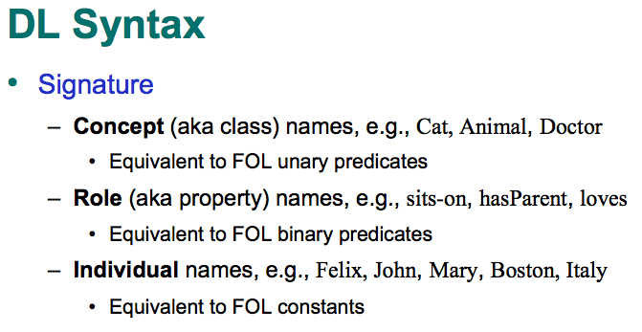
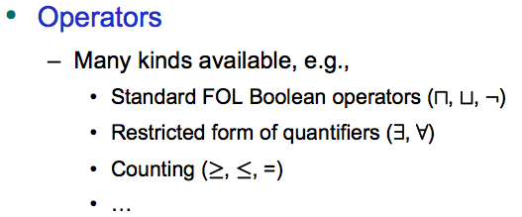
Description logic
http://www.cs.ox.ac.uk/ian.horrocks/Seminars/download/Horrocks_Ian_pt1.pdf
Goal: Make it easier to describe categories (as opposed to objects)
Popularized by projects such as the Semantic Web

Slide 48
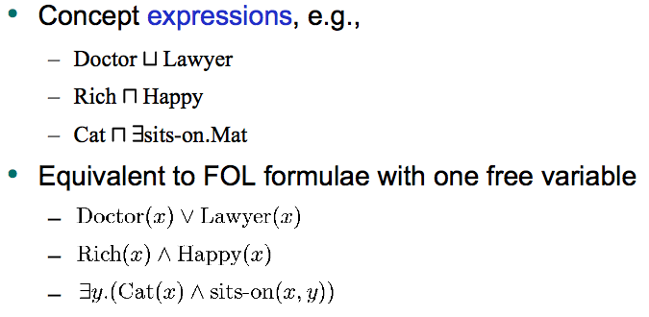
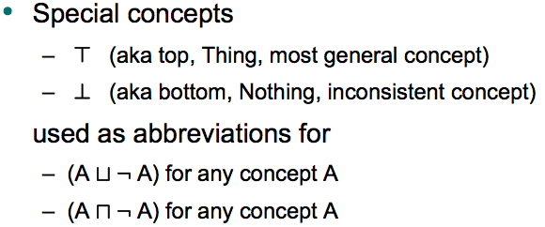
Description logic
http://www.cs.ox.ac.uk/ian.horrocks/Seminars/download/Horrocks_Ian_pt1.pdf

Slide 49
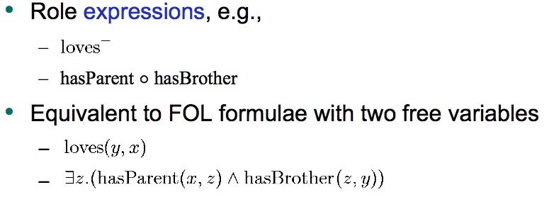
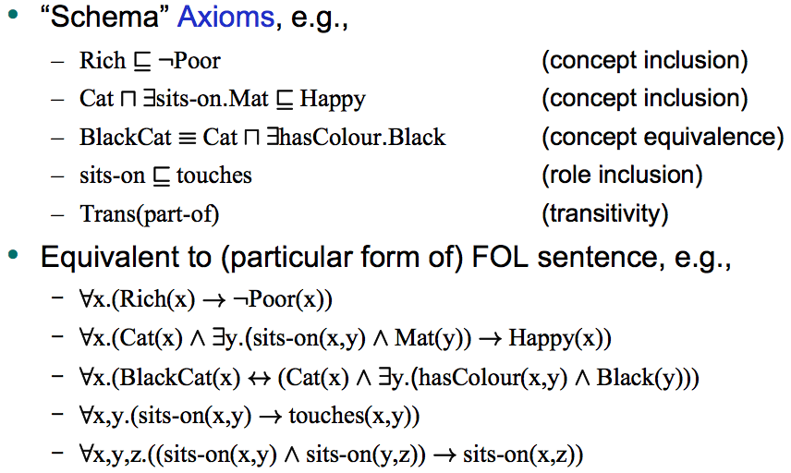
Description logic
http://www.cs.ox.ac.uk/ian.horrocks/Seminars/download/Horrocks_Ian_pt1.pdf

Slide 50
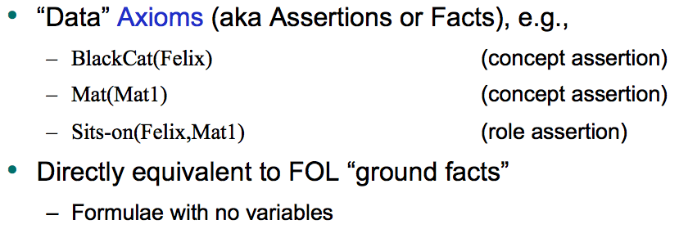
Description logic
http://www.cs.ox.ac.uk/ian.horrocks/Seminars/download/Horrocks_Ian_pt1.pdf
Knowledge base = set of axioms (TBox) + set of facts (ABox)

Slide 51
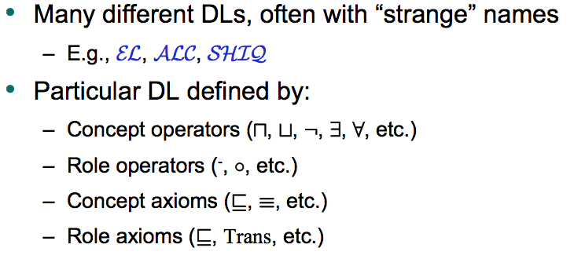
The DL family
http://www.cs.ox.ac.uk/ian.horrocks/Seminars/download/Horrocks_Ian_pt1.pdf

Slide 52
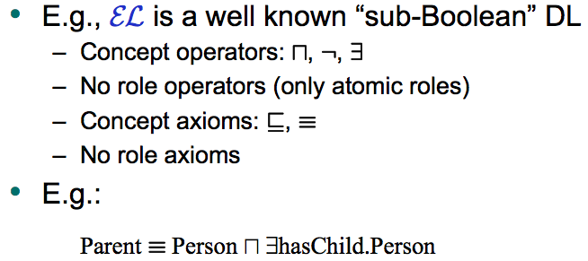
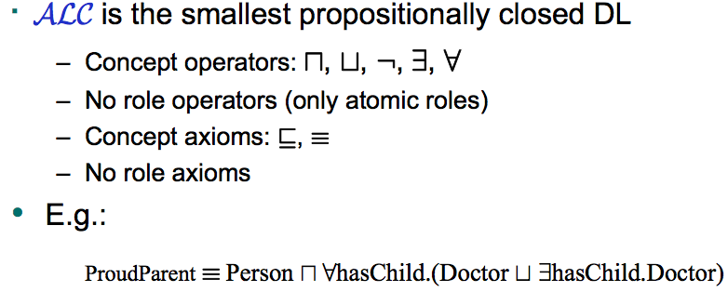
The DL family
http://www.cs.ox.ac.uk/ian.horrocks/Seminars/download/Horrocks_Ian_pt1.pdf

Slide 53
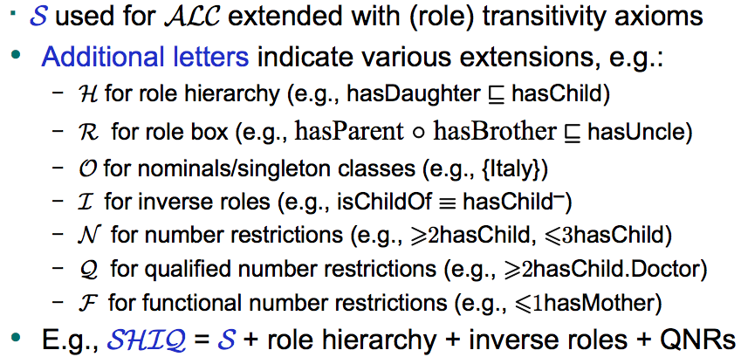
The DL family
http://www.cs.ox.ac.uk/ian.horrocks/Seminars/download/Horrocks_Ian_pt1.pdf

Slide 54
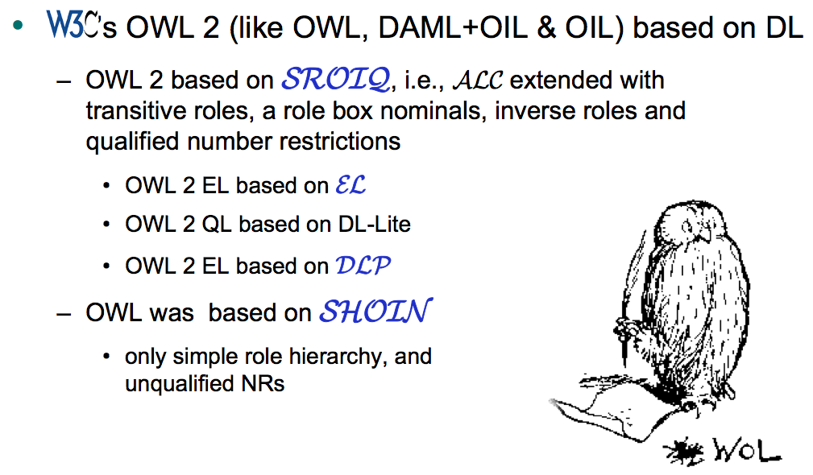
Example
http://www.cs.ox.ac.uk/ian.horrocks/Seminars/download/Horrocks_Ian_pt1.pdf

Slide 55
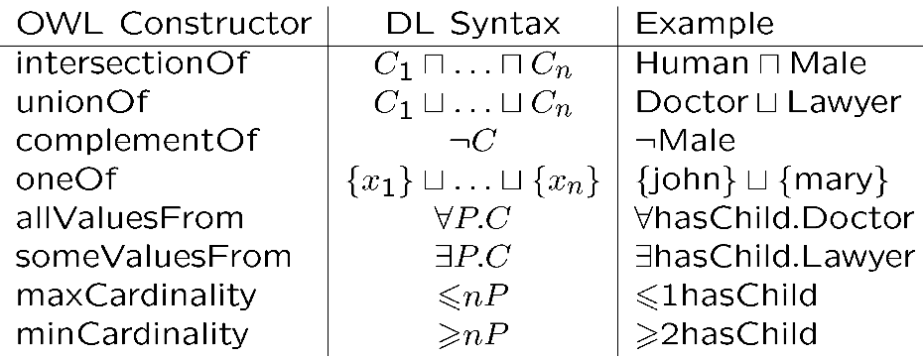
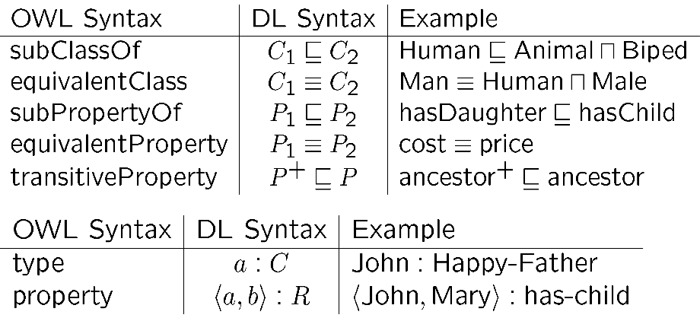
Example: OWL2
http://www.cs.ox.ac.uk/ian.horrocks/Seminars/download/Horrocks_Ian_pt1.pdf

Slide 56
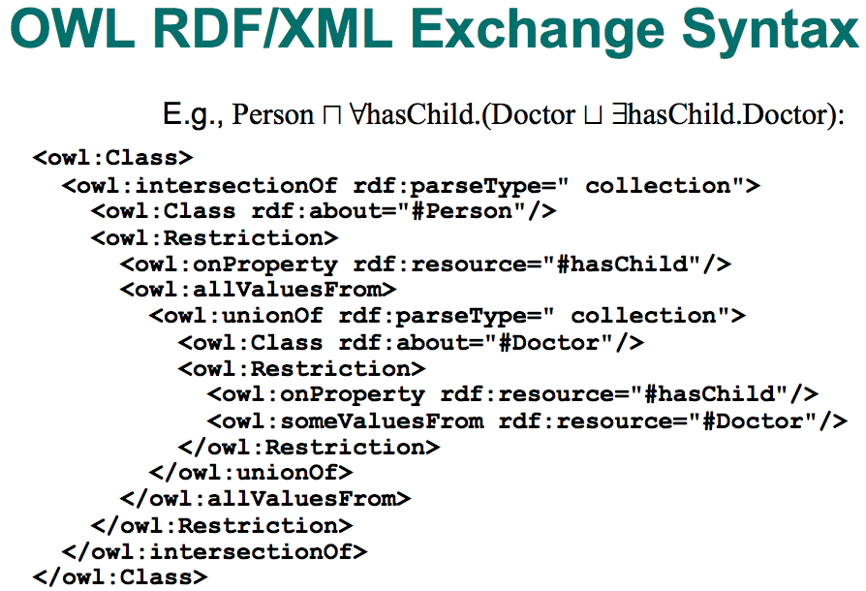
Example: OWL2
http://www.cs.ox.ac.uk/ian.horrocks/Seminars/download/Horrocks_Ian_pt1.pdf

Slide 57
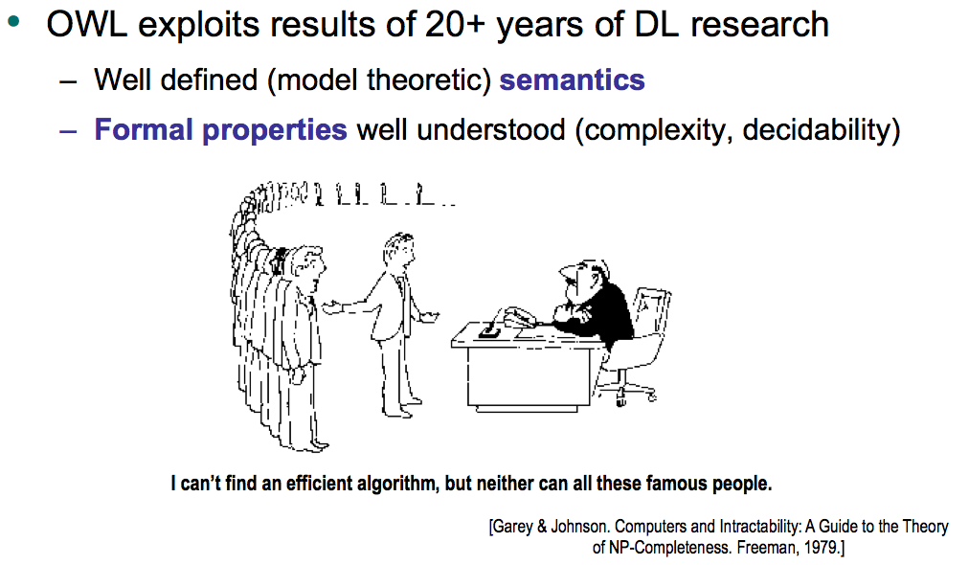
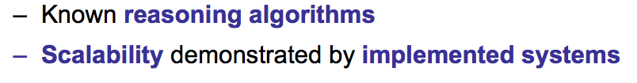
Why description logics?
http://www.cs.ox.ac.uk/ian.horrocks/Seminars/download/Horrocks_Ian_pt1.pdf

Slide 58
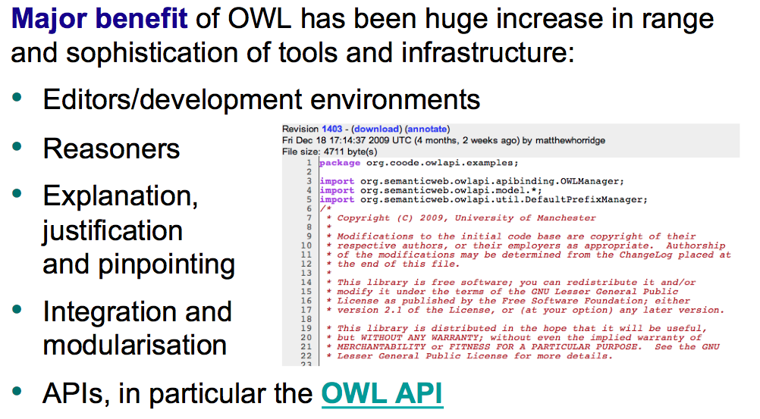
Why description logics?
http://www.cs.ox.ac.uk/ian.horrocks/Seminars/download/Horrocks_Ian_pt1.pdf

Slide 59
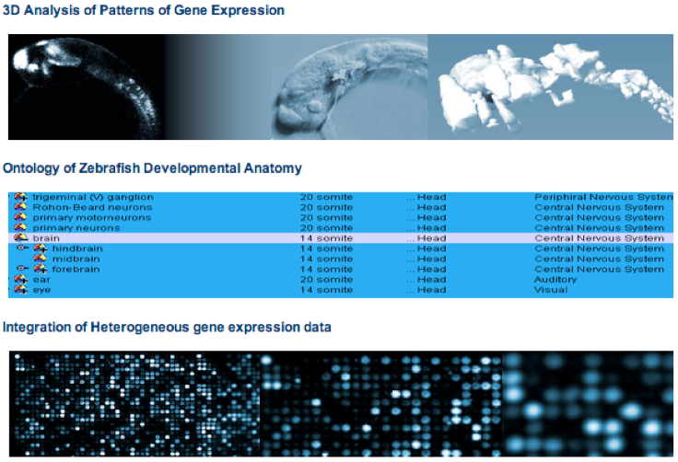

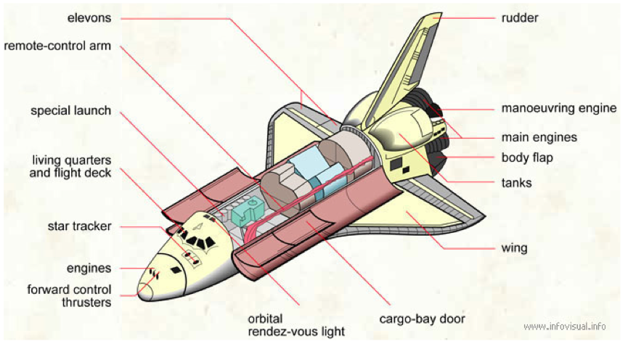
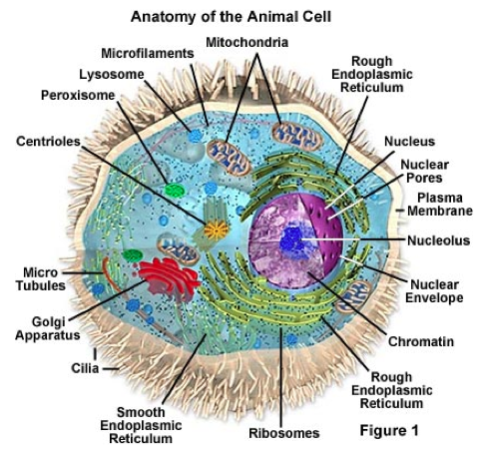
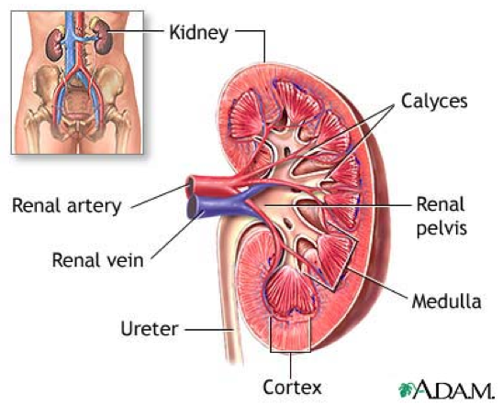
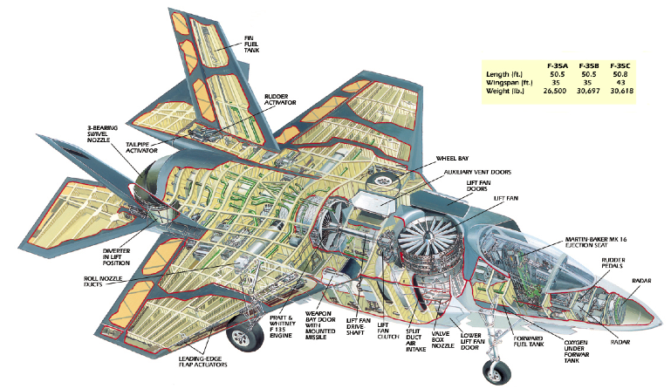
Many applications
http://www.cs.ox.ac.uk/ian.horrocks/Seminars/download/Horrocks_Ian_pt1.pdf
Science (e.g., genomics), geography, engineering
Medicine, biology, defense

